Slide 1
An introduction to MECHANICAL VENTILATION
Ahmad bagheri moghadam
MD. FCCM

Slide 2
Physics
Notes:
In simple terms the lung-ventilator unit can be thought of as a tube with a balloon on the end with the tube representing the ventilator tubing, ET tube and airways and the balloon the alveoli. Gas is pumped into the lung during inspiration and flows out passively during expiration

Slide 3
Physics
Volume/compliance
Flow x resistance
Notes:
The pressure required to overcome the resistance of the tube is determined by the flow down the tube and the resistance to flow

Slide 4
Physics
A (P_{AW})
(Volume/compliance) + PEEP
Flow x resistance
Notes:
This baseline pressure is the pressure in the balloon at then end of expiration, which is known as positive end expiratory pressure or PEEP. Thus airway pressure is equal to flow x resistance plus volume divided by compliance plus PEEP.

Slide 5
Physics
A (P_{AW})
(Volume/compliance) + PEEP
Flow x resistance
Notes:
The component due to alveolar pressure is equal to volume divided by compliance plus PEEP

Slide 6
Physics
Only possible to set 2 of:
Pressure
Flow
Volume
Other variable becomes a dependent variable
Notes:
As pressure, flow and volume are all related it is only possible to set any 2 of these three variables, with the third variable being dependent on the settings for the other two.

Slide 7
Physics
If time is set it is only possible to set one of:
Pressure
Volume
Flow
Notes:
However flow is equal to volume divided by time so if time is set it is only possible to set one of pressure, volume or flow

Slide 8
Main determinants
Oxygen in
↑ FIO2
↑ mean alveolar pressure
PEEP
Re-open alveoli and ↓ shunt
Carbon dioxide out
↑ ventilation
↑ RR
↑ tidal volume
Notes:
The most important means of improving oxygenation are increasing the inspired concentration of oxygen, increasing the mean airway and therefore the mean alveolar pressure and applying PEEP to re-open alveoli. Carbon dioxide removal can be increased by increasing the respiratory rate or tidal volume

Slide 9
Mean airway pressure
↑ Tidal volume
Pressure
Pressure
Mean airway pressure
Mean airway pressure
Time
Time
Notes:
Airway pressure can be increased in a number of ways. It is easier to understand why these methods increase mean pressure if one remembers that the mean airway pressure refers to the mean across the entire respiratory cycle, both inspiration and expiration.
The most obvious method of increasing the pressure is to increase the tidal volume but this will also increase the peak and plateau airway pressures and therefore increase the chance of ventilator induced lung injury.

Slide 10
Mean airway pressure
↑ PEEP
Pressure
Pressure
Mean airway pressure
Mean airway pressure
Time
Time
Notes:
Finally increasing the positive end-expiratory pressure or PEEP will increase the mean pressure but may also increase the peak and plateau pressures.

Slide 11
Mean airway pressure
↑ Inspiratory time
Pressure
Pressure
Mean airway pressure
Mean airway pressure
Time
Time
Notes:
Prolonging the inspiratory time increases the mean pressure without increasing the peak pressure

Slide 12
Inspiratory time
Set as:
% of respiratory cycle
I:E ratio
Fixed time
Indirectly, by setting flow
Expiratory time not set
Remaining time after inspiration before next breath
Notes:
It can be set as a percentage of the respiratory cycle or as a ratio of inspiration to expiration, the so called I:E ratio. Note that on most ventilators the expiratory time is not set directly but is merely the remaining time after inspiration before the next breath

Slide 13
Breath types
Classified by:
Trigger variable: what initiates the breath
Limit variable: what controls gas delivery during the breath
Cycle variable: what terminates the breath
Pressure is usually a “backup” cycle variable to terminate gas delivery if circuit pressure rises above an alarm limit
Notes:
demand valve senses a negative airway pressure deflection (generated by the patient trying to initiate a breath) greater than the trigger sensitivity. A trigger sensitivity of -1 to -3 cmH2O is typically set.
Flow-by triggering: when return flow is less than delivered flow due to pt’s effort to initiate breath

Slide 14
Breath type: Spontaneous vs Mechanical vs assisted
Mechanical
Assisted
Inspiration
P_{aw}
(cm H₂O)
Spontaneous
Expiration
Expiration
Inspiration
Time (sec)

Slide 15
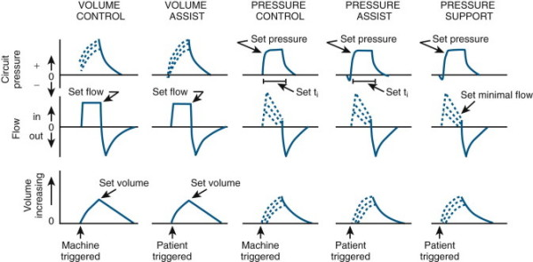
5 basic breaths
FIGURE 89-1 ▪ Circuit pressure, flow, and volume tracings over time depicting the five basic breaths available on most modern mechanical ventilators. Breaths are classified by the variables that determine the trigger (machine time or patient effort), target/limit (set flow or set pressure), and cycle (set volume, set time, or set flow). The solid lines represent set or independent responses, and the dashed lines represent dependent responses.

Slide 16
Volume-limited
Volume-limited
Clinician sets peak flow rate, flow pattern (ramp vs square), tidal volume, respiratory rate, PEEP, and FiO2.
Inspiration ends after delivery of the set tidal volume.
(I:E) ratio determined by the peak inspiratory flow rate: ↑ peak inspiratory flow → ↓ inspiratory time, ↑ expiratory time, and ↓ I:E ratio
Airway pressures depend on set Vt and patient compliance and airway resistance
Notes:
Peak flow rates of 60 L per minute may be sufficient, although higher rates are frequently necessary.
Flow pattern: square wave (constant flow), a ramp wave (decelerating flow), and a sinusoidal wave (figure 3). The ramp wave may distribute ventilation more evenly than other patterns of flow, particularly when airway obstruction is present [22]. This decreases the peak airway pressure, physiologic dead space, and PaCO2, while leaving oxygenation unaltered [23].

Slide 17
Pressure-limited
Pressure-limited
Clinician sets inspiratory pressure level, I:E ratio, respiratory rate, PEEP, and FiO2
Tidal volume is variable and determined by inspiratory pressure, compliance, airway and tubing resistance
Peak airway pressure is constant and equal to sum of set inspiratory pressure and applied PEEP.
Notes:
tidal volumes will be larger when the set inspiratory pressure level is high or there is good compliance, little airway resistance, or little resistance from the ventilator tubing.

Slide 18
Volume-limited vs. Pressure-limited
The choice between volume-limited and pressure- limited modes is not supported by definitive evidence.
Volume- limited modes are preferred when it is crucial to maintain minute ventilation.
The pressure limited mode should be the preferred ventilator mode in patients with inhomogeneous lungs.

Slide 19
CONTROLLED MECHANICAL VENTILATION)

Slide 20
The variable used by the ventilator (and set by the health care provider) to trigger and to cycle off the breath is time.
The limit variable that governs gas delivery may be flow (flow-limited controlled mechanical ventilation [CMV]) or pressure (pressure-limited controlled ventilation [PCV])

Slide 21
Time triggered, Flow limited, Volume cycled Ventilation
Preset Peak Flow
Flow
L/m
Dependent on
C_{L} & R_{aw}
Pressure
cm H₂O
Preset V_{T}
_{Volume Cycling}
Volume
mL
Time (sec)
Notes:
Controlled Mode (Volume- Targeted Ventilation)

Slide 22
Time Triggered, Pressure Limited, Time Cycled Ventilation
Time-Cycled
Flow
(L/min)
Set PC level
Pressure
(cm H₂O)
Volume
(ml)
Time (sec)
Notes:
Controlled Mode (Pressure-Targeted Ventilation)

Slide 23
Current ventilators do not have a CMV setting; this mode is essentially what is achieved when a patient on assist control (AC) ventilation has no interaction with the ventilator secondary to heavy sedation or neu- romuscular blockade.

Slide 24
ASSISTED MECHANICAL VENTILATION

Slide 25
Patient triggered, Flow limited, Volume cycled Ventilation
Flow
L/m
Pressure
cm H₂O
Preset V_{T}
_{Volume Cycling}
Volume
mL
Time (sec)
Notes:
Assisted Mode (Volume-Targeted Ventilation)

Slide 26
Patient Triggered, Pressure Limited, Time Cycled Ventilation
Time-Cycled
Flow
(L/min)
Pressure
Set PC level
(cm H₂O)
Volume
(ml)
Time (sec)
Notes:
Assisted Mode (Pressure-Targeted Ventilation)

Slide 27
Assist/Control Mechanical Ventilation
The patient is allowed to set the respiratory rate by activating the inspiratory trigger function (as a safety measure, if no spontaneous effort occurs, the ventilator will deliver controlled breaths at a preselected backup rate.)
The limit variable that governs gas delivery is flow and volume ( [A/CMV]) or pressure[A/PCV])
The variable used by the ventilator to cycle off the breath is time.

Slide 28
Synchronized Intermittent Mandatory Ventilation
Allows the patient to breathe spontaneously between intermittent mandatory controlled breaths.
Controlled breaths are delivered in a synchronous manner with the patient’s spontaneous effort.
Controlled breaths may be volume-cycled or pressure-cycled

Slide 29
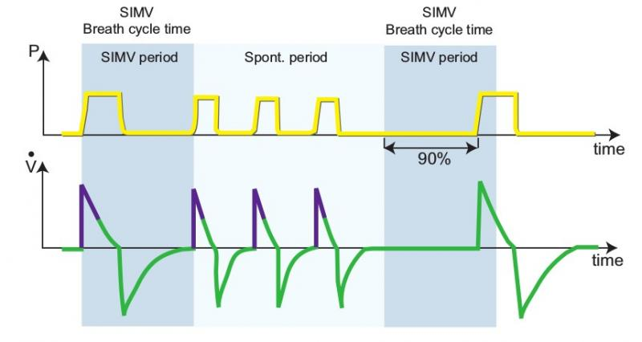

Slide 30
Flow
(L/min)
Pressure
(cm H₂O)
Volume
(ml)
Spontaneous Breaths
Notes:
SIMV (Volume-Targeted Ventilation)

Slide 31
Flow
(L/min)
Pressure
Set PC level
(cm H₂O)
Volume
(ml)
Time (sec)
Spontaneous Breath
Notes:
SIMV Mode (Pressure-Targeted Ventilation)

Slide 32
Pressure Support Ventilation
During PSV, the patient’s spontaneous effort triggers the ventilator and is subsequently assisted by a constant positive pressure
Cycling from the inspiratory to the expiratory phase in PSV occurs when inspiratory flow rate decreases to a preset level.

Slide 33
Time-Cycled
Flow-Cycled
Flow
(L/min)
Pressure
Set PC level
Set PS level
(cm H₂O)
Volume
(ml)
Time (sec)
PS Breath
Notes:
SIMV + PS (Pressure-Targeted Ventilation)

Slide 34
Flow-cycled
Flow
(L/min)
Pressure
Set PS level
(cm H₂O)
Volume
(ml)
PS Breath
Notes:
SIMV+PS (Volume-Targeted Ventilation)

Slide 35
Flow
(L/min)
Pressure
Set PC level
Set PS level
(cm H₂O)
CPAP level
Volume
(ml)
Time (sec)
Notes:
SIMV + PS + CPAP (Pressure-Targeted Ventilation)

Slide 36
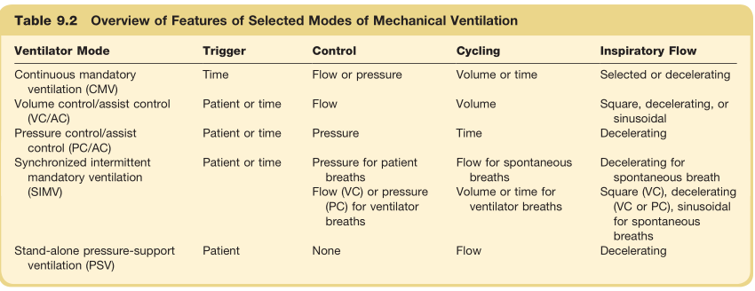

Slide 37
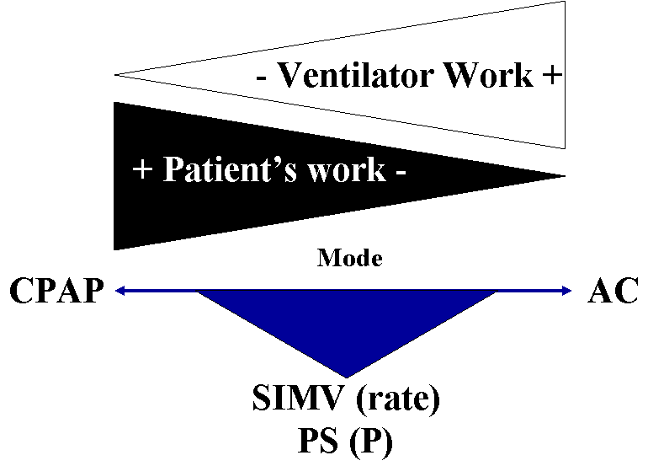
Partitioning of the Workload Between the Ventilator and the Patient
How the work of breathing partitions between the patient and the ventilator
depends on:
Mode of ventilation (e.g., in assist control most of the work is usually done by the ventilator)
Patient effort and synchrony with the mode of ventilation
Specific settings of a given mode (e.g., level of pressure in PS and set rate in SIMV)

Slide 38
MONITORING MECHANICAL VENTILATION

Slide 39
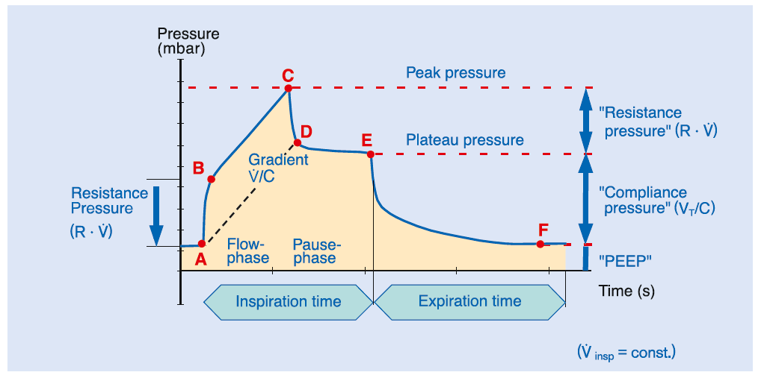

Slide 40
Air Trapping
Inspiration
Normal
Patient
Time (sec)
Flow (L/min)
}
Air Trapping
Auto-PEEP
Expiration

Slide 41
Patient-ventilator interactions
Trigger Asynchrony
Gas Delivery Asynchrony
Cycling Asynchrony

